Slide 1
Power-efficient memory and caches
Jothini Sritharan
Green Computing

Slide 2
Introduction

Slide 3
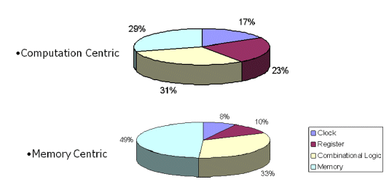
Motivation
Power-consumption distribution in a SoC Design (Integrated Circuit)

Slide 4
Content
Revision: Memory organization and caches
Energy consumption concerning memory access
Ideas of reducing power consumption
Low power memory design

Slide 5
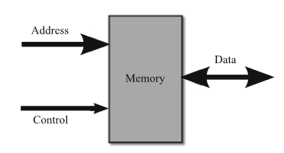
1. Memory organization and caches
Input:
→ address: location of memory which is
accessed
→ control: indicates important data;
signals kind of operation
Bidirectional bus:
→ data: depending on operation it serves as input or output

Slide 6
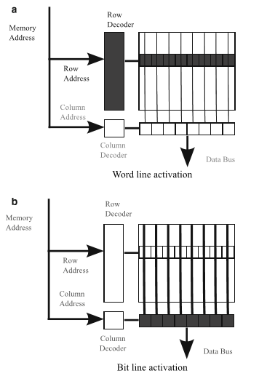
Read operation:
1. row address decoded
→ activates word line
2. selection of a row of cells
→ transfer of data between cells
and bit lines
3. column decoder chooses bits in right
column and transfers them to data bus

Slide 7
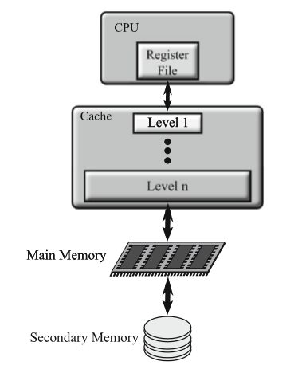
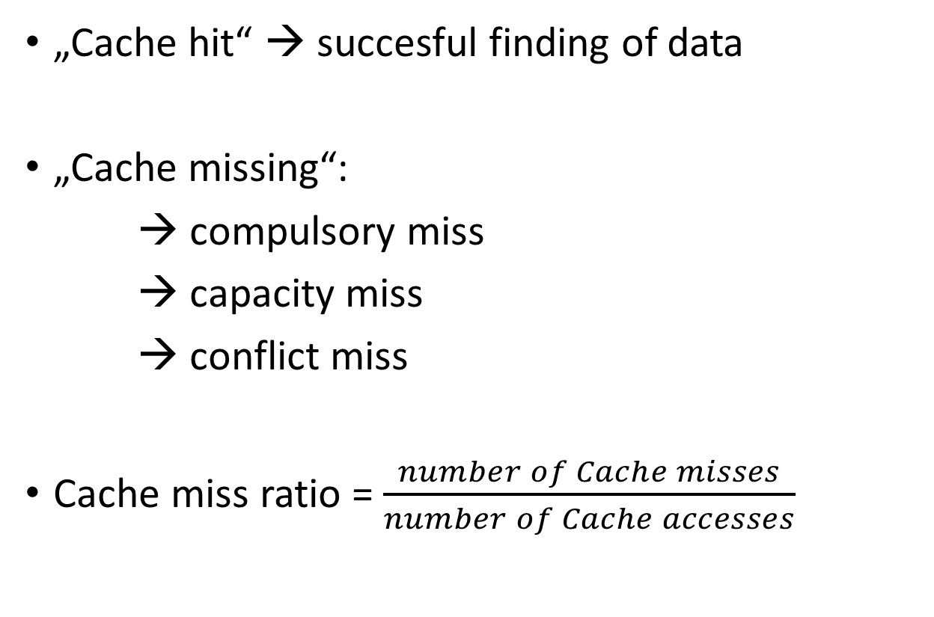
Cache
„Cache hit“ → succesful finding of data
„Cache missing“:
→ compulsory miss
→ capacity miss
→ conflict miss
Cache miss ratio = $\frac{number of Cache misses}{number of Cache accesses}$

Slide 8
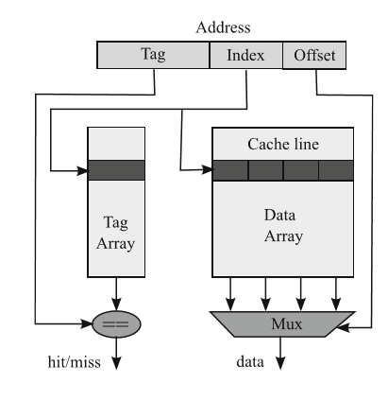
Cache architecture
Cache hit:
tag matches to an element of tag array
Index collects corresponding tag and cache line
Offset chooses right data from selected line

Slide 9
2. Energy consumption concerning memory access
The following three main components basically determine the energy consumption:
1. address decoders and word lines
2. data array, sense ampliﬁers and the bit lines
3. the data and address buses leading to the memory

Slide 10
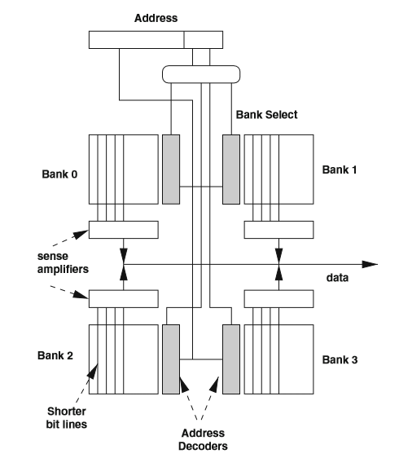
3. Ideas of reducing power consumption 3.1 Power-efficient memory Architectures
Partitioning memory and caches
memory array is divided into several
banks → shorter transferring path
because of smaller bit lines

Slide 11
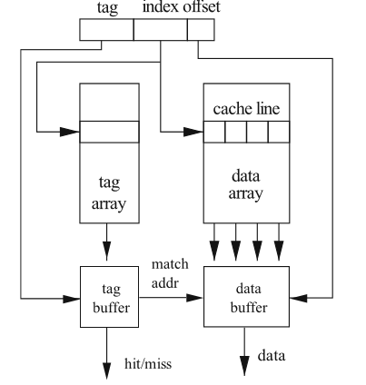
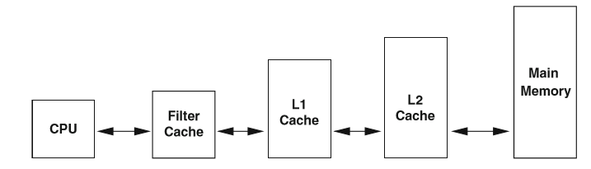
Additional memory
a small extra cache, which stores recently used
data, is searched first and may prevent
browsing through the whole main cache

Slide 12
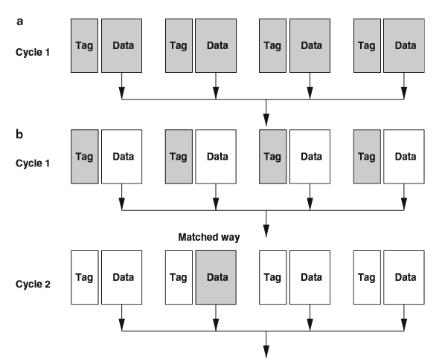
Reducing Tag and Data Array Fetches
Reducing number of accesses by only searching the tags without data first
Then picking only the data of the right tag

Slide 13
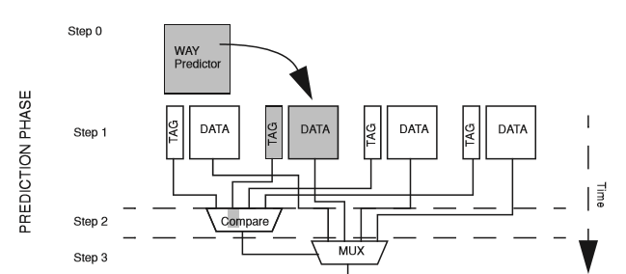

Slide 14
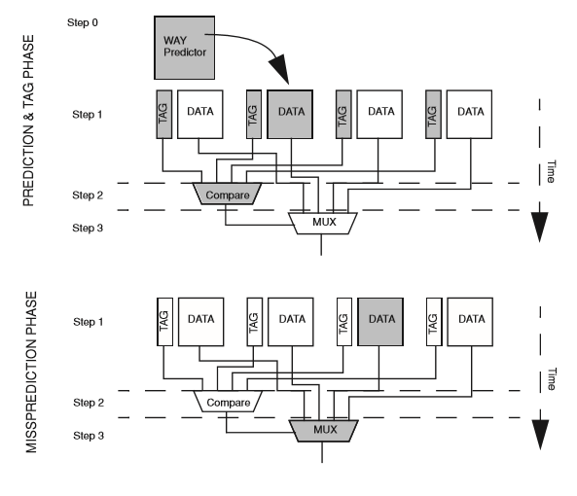

Slide 15
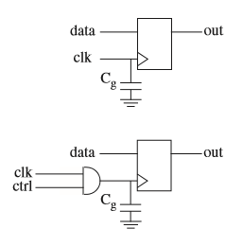
3.2 Clock-Gating
By connecting the clock with a control signal
by an AND Gatter, the capacitance is only
charged and discharged when control is
on TRUE

Slide 16
3.3 Cacheable switching activity
Recurring instructions are stored in a cache
→ calculation has to be done only once
Example: For loops
→ But only applicable when same input

Slide 17
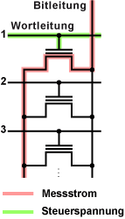
4 Low power memory design
4.1 NOR-Flash-Memory
Fast random access since a transistor can be
individually adressed due to the parallel circuit

Slide 18
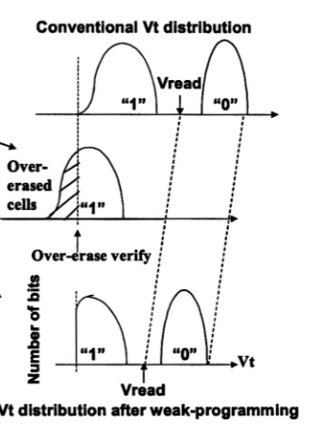
Bit-by-bit-weak program
Applying lower voltage than ordinary
Offset of whole curve
→ Lower voltage is needed

Slide 19
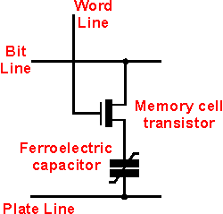
4.2 Ferroelectric Random Access Memory (FeRAM)
Selecting transistor
Capacitor saves information in form of polarization
Reading: another voltage impulse leads to either a change or a constancy in polarization

Slide 20
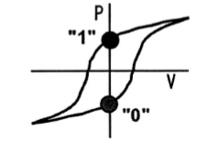
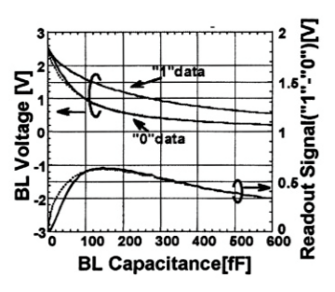
Two stable states at the voltage of 0V
Readout-signal depends on used capacitance
→ has a maximum
Jothini Sritharan: Power-efficient memory and caches

Slide 21
Summary
Memory and caches are responsible for a large share of power-consumption
→ necessity for power-efficient caches and memories
General solutions:
Optimization of Cache architecture
Additional memory with most recently used data
Adaption of components like transistors and capacitances

